Slide 1


Medictionary
Jeongyun Lee
Ronnel Mattew
Eyad Al Hafi
Marc Visa

Slide 2

Index
01. Team Members
02. Project Summary
03. Sprint planning & progress
04. Financial Factors
05. Prototype & Improvement

Slide 3

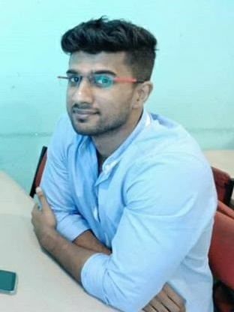


01. Team Members
Jeongyun Lee
Ronnel Mathew
Marc Visa
Eyad Al Hafi

Slide 4
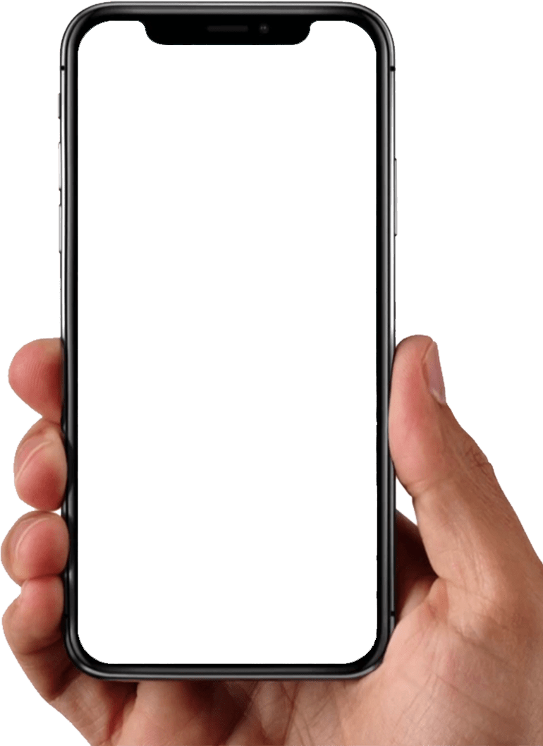
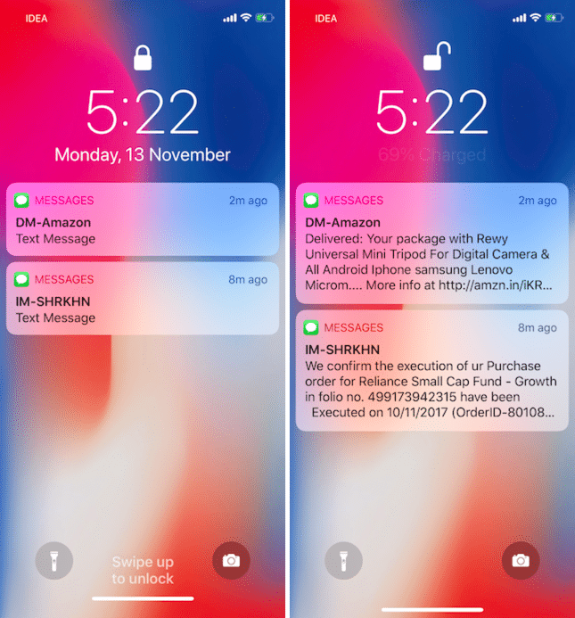





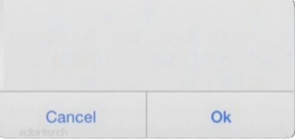
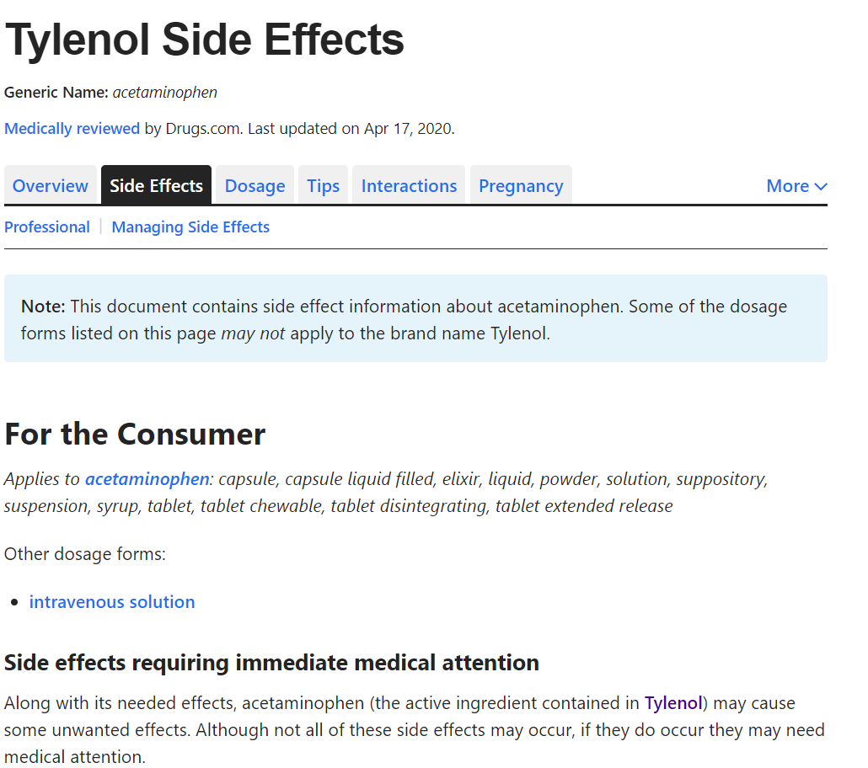


02.Project Summary
Searching The Pills
Searching the pills with the shape, the color and the code
white, oval, paracetamol
Providing the information of the pill including the ingredients, dosage , effects and etc.
You missed the medicine
CAUTION!
Your medicine A and B is conflicted
They can cause the side effect
Jake needs to take his medicine in 30 min
Setting Alarms
Reminding the time to take the medicine for user and user’s family
CAUTION!
Do Not Drink - Tyrenol
Alcohol can damage your liver.
Cautions
Notification the guide line in the daily life

Slide 5

03. Sprint Planning & Progress – Sprint Goal
FUNCTION 0 SIGN IN, SIGNUP
FUNCTION1 SEARCH
DOCUMENTATION
FUNCTION 2 ALARM
FUNCTION 3 NOTIFICATION
Connecting Search to API
3rd Sprint
2nd sprint
FUNCTION 2 ALARM
-finish the Alarm setting
FUNCTION 3 NOTIFICATION
-connect the noti with user info
FUNCTION 4 SETTING
-users can update user info
UI IMPROVEMENT
1st sprint

Slide 6
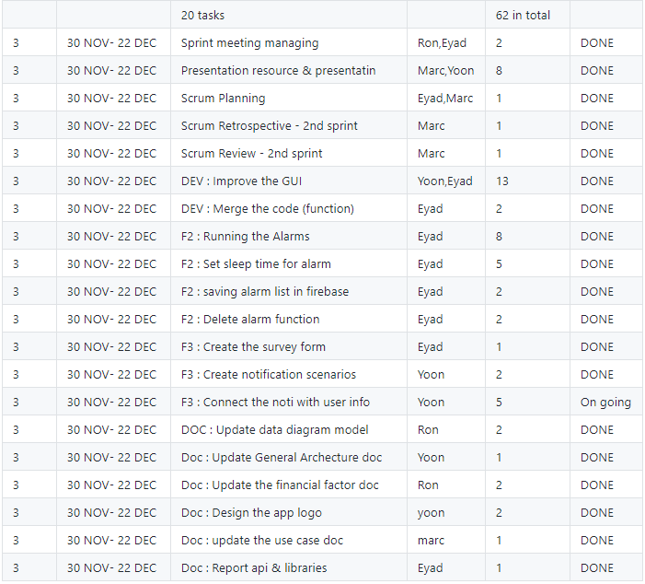
03. Sprint Planning & Progress – Sprint Progress
Title | Owned
Documetation | Marc, Ronnel
F2 : Running alarms | Eyad
F3 : Notification | Eyad , Yoon
GUI | Yoon
SCRUM Managing | Marc , Ronnel

Slide 7
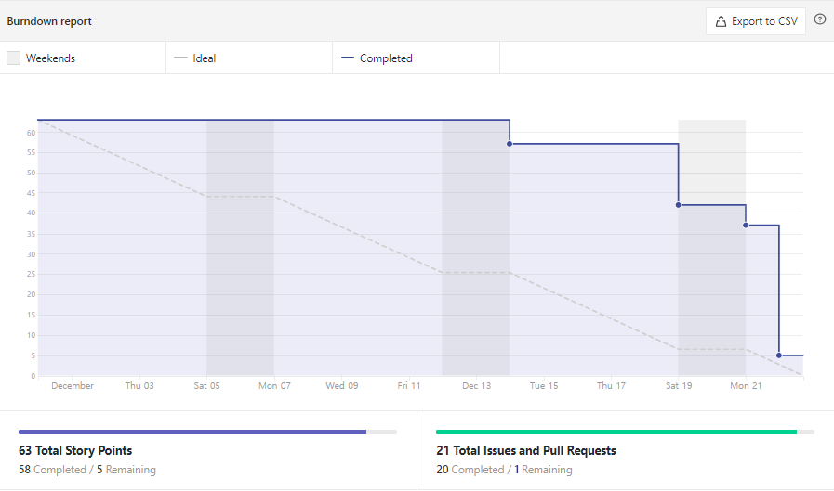
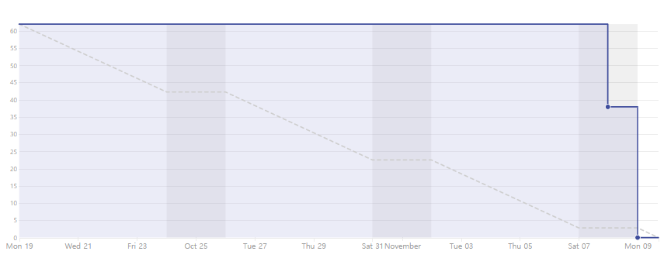
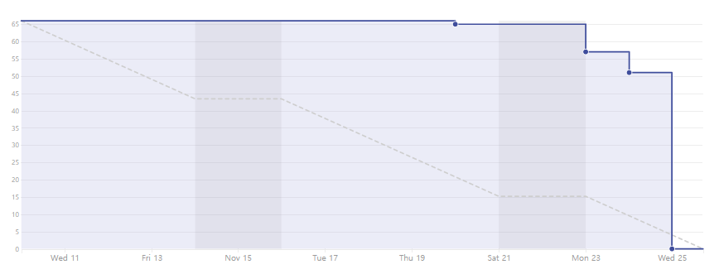
03. Sprint Planning & Progress – Sprint Progress
03. Sprint Planning & Progress – Sprint Progress
1st Sprint
3rd Sprint
2nd Sprint

Slide 8


03. Sprint Planning & Progress
ISSUES
API
API will retire in 2 months.
Won´t be update
Not affected as the API will not be deleted
Sprint meeting
Personal Business : Work, Travel, Time zone difference, Visa
No place, No time

Slide 9
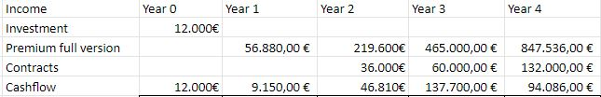

04. Financial Factors - Cash Flow
Year 4
Year 3
Year 2
Year 0
Year 1
Notes:
1st Year:
- Income → Premium version (1083 users)
- Costs → Ads + Marketing
- Cash Flow: 9.150,00 €
2nd Year:
- Income → Premium version (2808 users) + Nutris + Ferrer
- Costs → Ads + Marketing + Commercial + Dev & Admin
- Cash Flow: 46.810,00 €
3rd Year:
- Income → Premium version (5536 users) + MAYO + Nutris + Ferrer + Farmacias Direct + Sanitas Insurance
- Costs → Ads + Marketing + Commercial + Dev & Admin + Server + Partners profit
- Cash Flow: 9.150,00 €
4th Year:
- Income → Premium version (9648 users) + MAYO + Nutris + Ferrer + Farmacias Direct + Sanitas Insurance + KERN
- Costs → Ads + Marketing + Commercial + Dev & Admin + Server + Partners profit + new country (USA) costs
- Cash Flow: 46.810,00 €

Slide 10
04. Financial Factors - Cash Flow
The main sources of income would be:
Premium Subscription
Initial Investments
Contracts

Slide 11






04. Financial Factors - Contracts Description

Slide 12
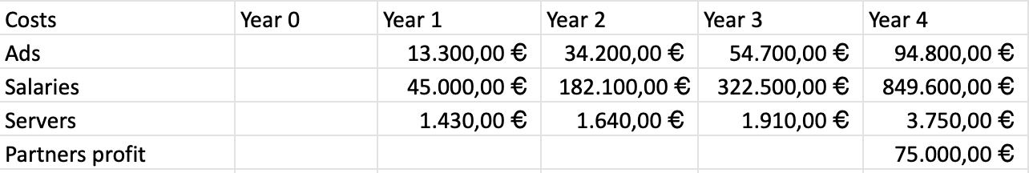
04. Financial Factors - Cost Structure

Slide 13







04. Financial Factors - Benefits
Commercial Manager
trading, commerce, finance etc
Marketer
Contract, media AD etc
Development
& Administration Manager
supervise the employees

Slide 14

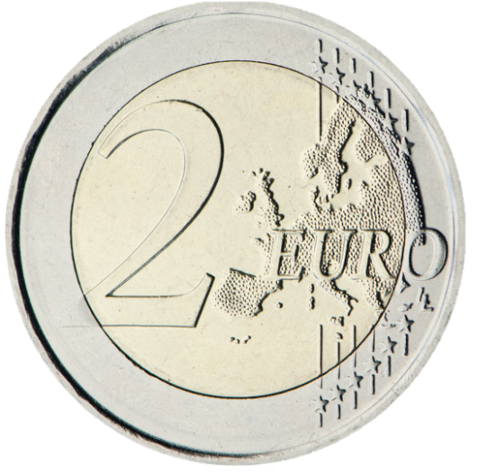


04. Financial Factors - Payback, ROI
Payback
0,93
11 months
ROI
6,13
Net Income 85.505,87 €

Slide 15
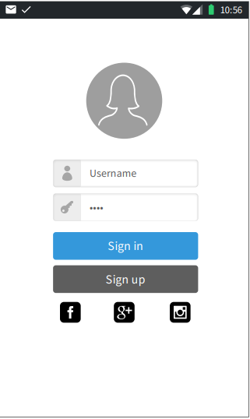
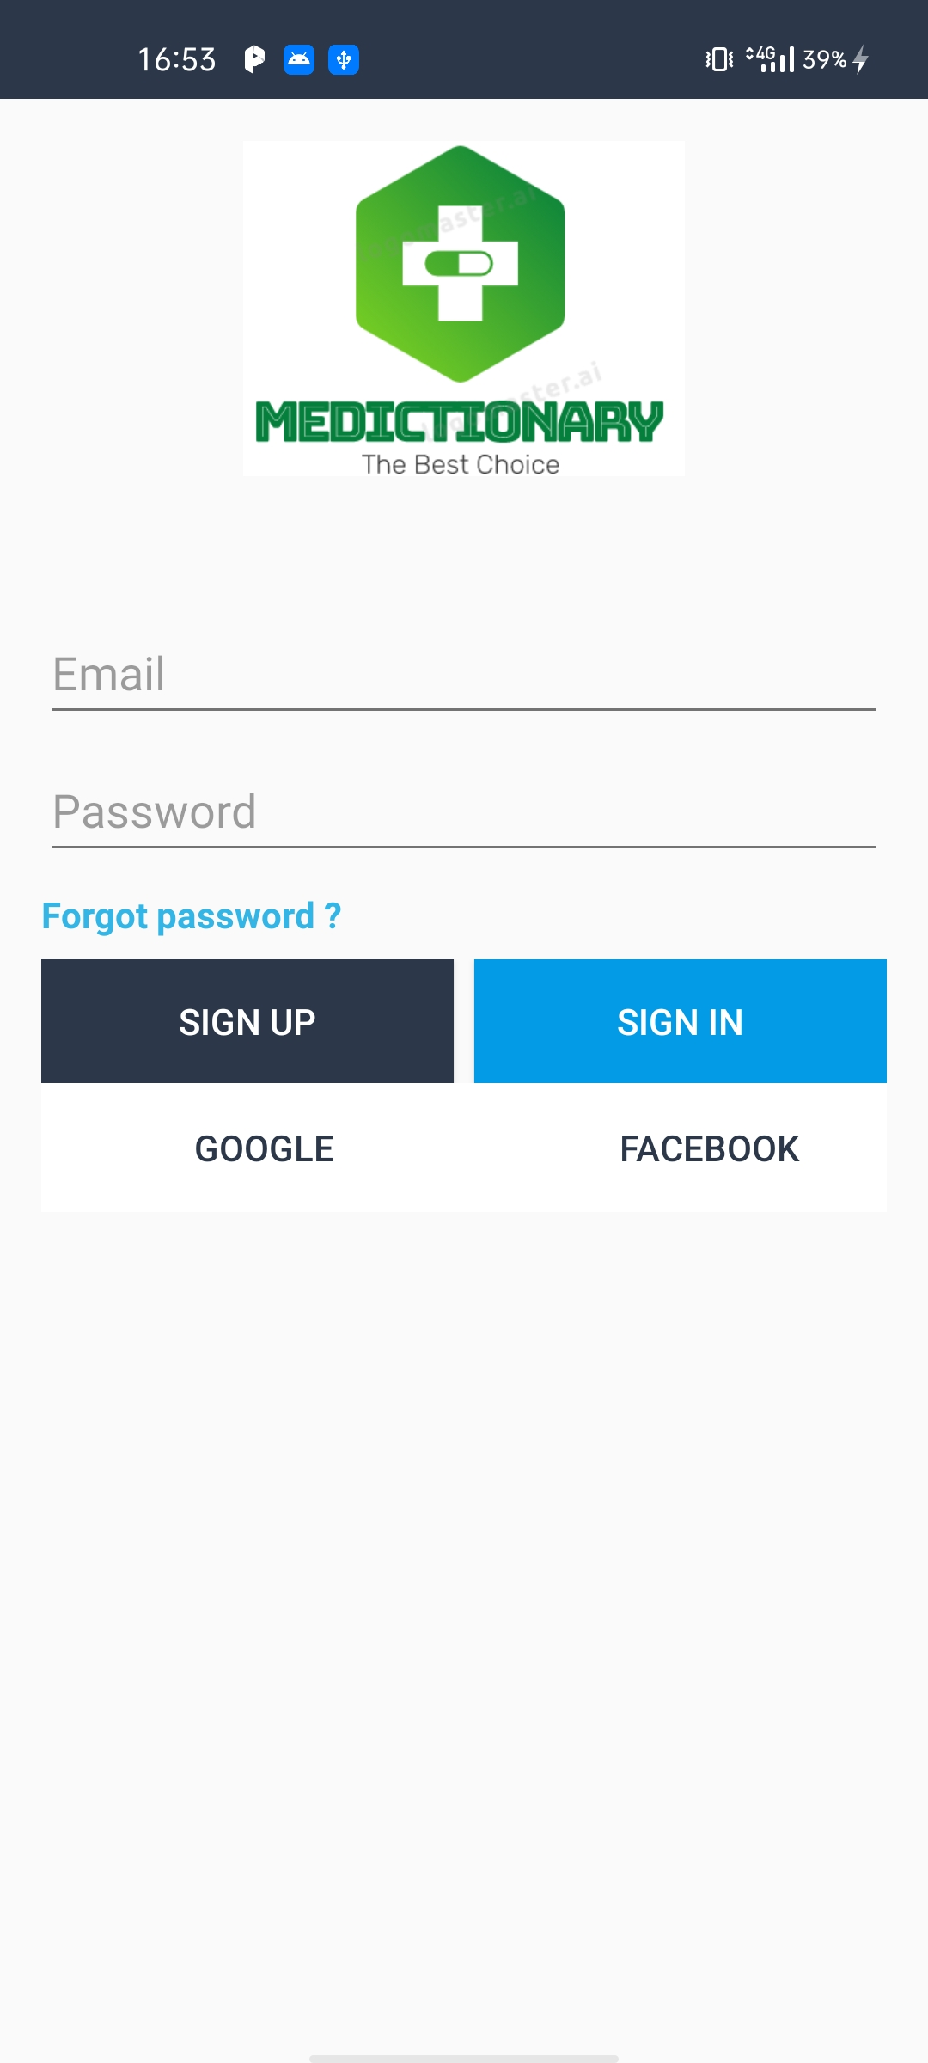
05. Prototype & Improvement
Function 0 : Sign up, Sign in

Slide 16
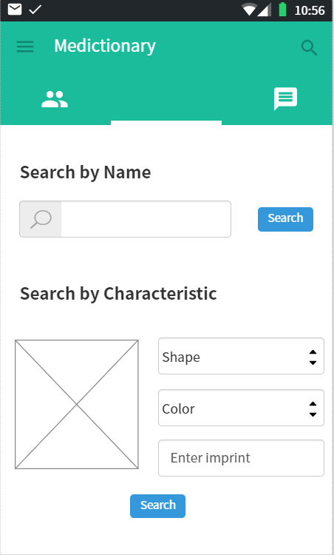
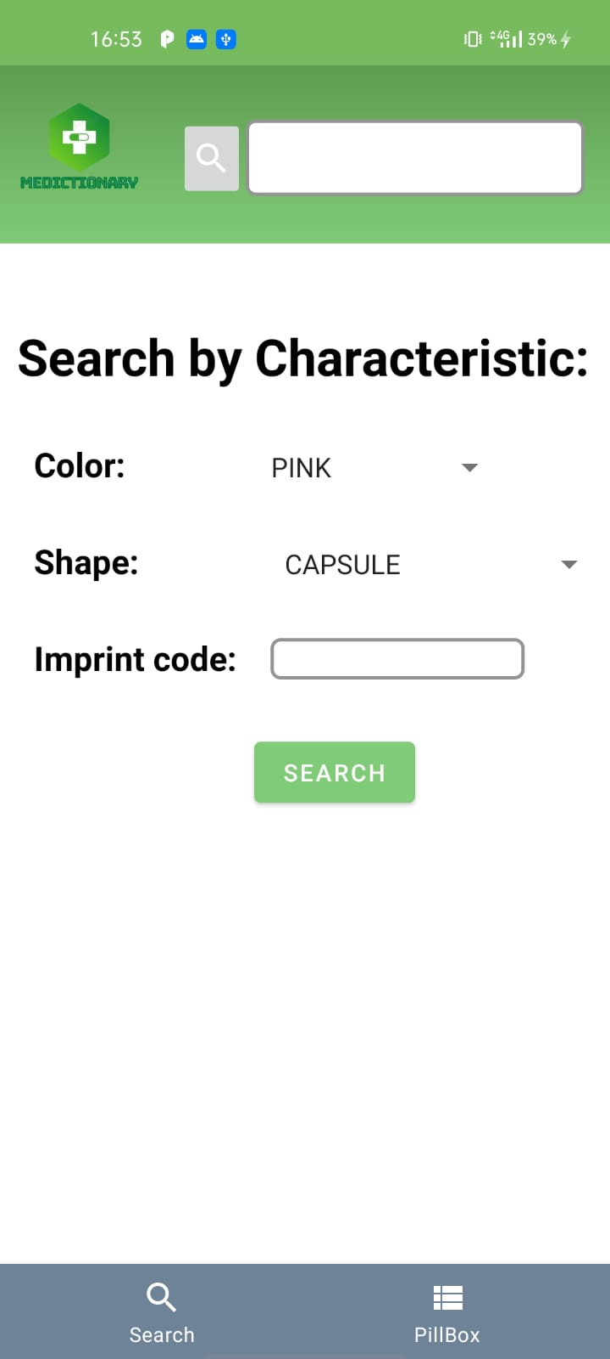
05. Prototype & Improvement
Function 1 : Searching
When the user doesn’t know about the name, they can find the pill with the color, shape, imprint

Slide 17
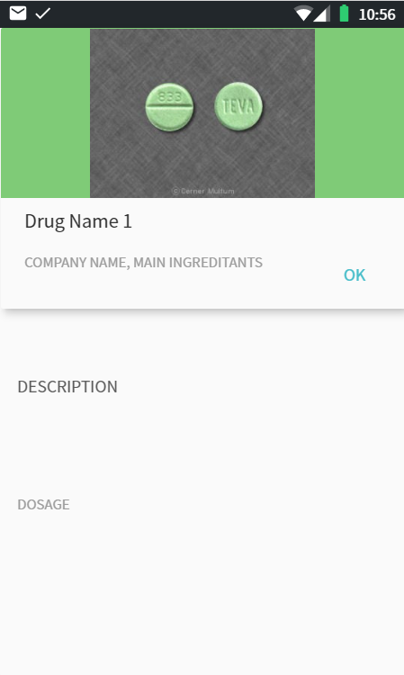
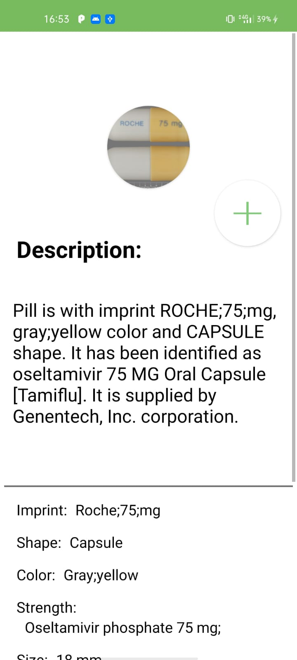
05. Prototype & Improvement
Function 1 :
Printing Information
The user can see the detailed information like the name of pills, description and side effects of pills.

Slide 18
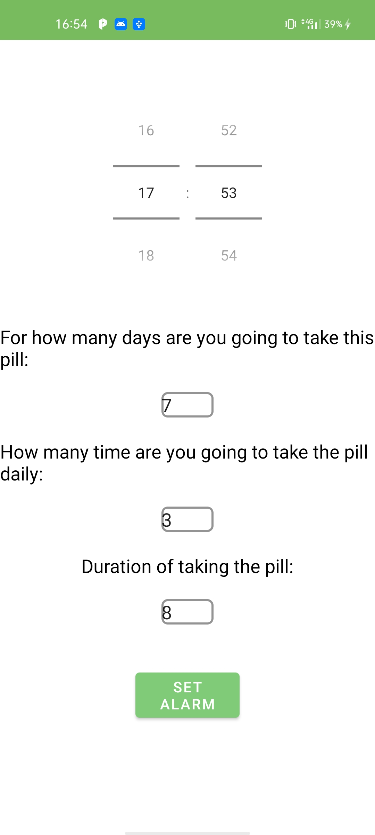
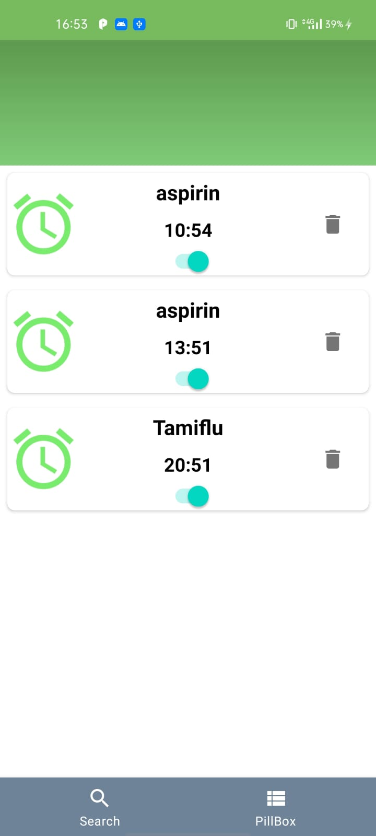
05.Prototype & Improvement
Function 2 : Setting Alarm
Check pills are taking.
Set alarm for each pill.
Remove or modify each pill (button next to the pill).

Slide 19
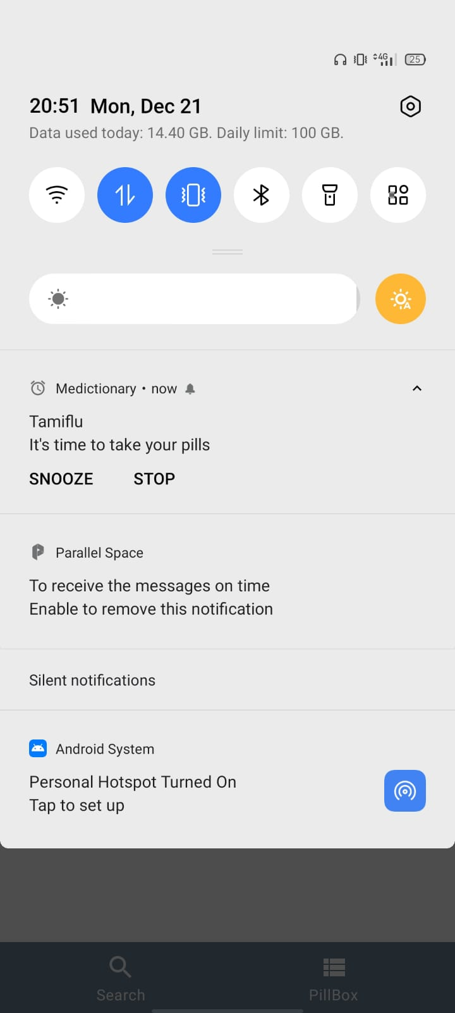
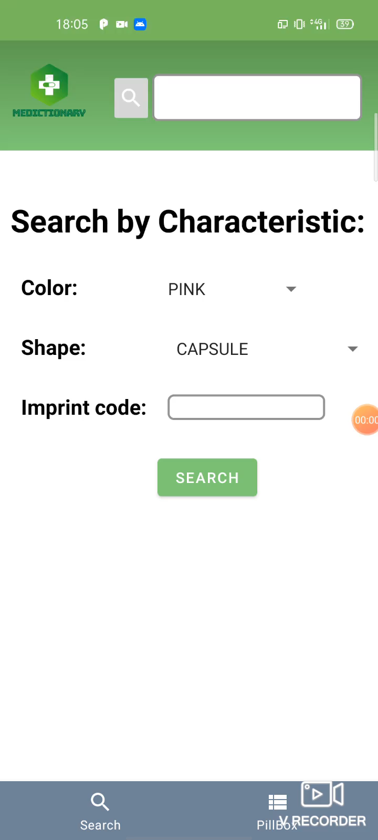
05. Prototype & Improvement

Slide 20

Q & A
Github
https://github.com/jy-977/ICT-medictionary
Jeongyun Lee
https://github.com/jy-977
Marc Visa
https://github.com/mvp17
Ronnel Mathew
https://github.com/ron7858
Eyad Al Hafi
https://github.com/eyadfhafi

Slide 21
Thank you for watching
Github
https://github.com/jy-977/ICT-medictionary
Jeongyun Lee
https://github.com/jy-977
Marc Visa
https://github.com/mvp17
Ronnel Mattew
https://github.com/ron7858
Eyad Al Hafi
https://github.com/eyadfhafi

